Slide 1

Analysis of factors affecting the GDP per capita. Of several countries
Presented by
Aishwarya Awasthi - 22125010
Amogh gupta - 231140005
Devansh Jindal - 231140007
Suraj choduary - 231140025
Saransh sharma - 231290012

Slide 2
Introduction:-
Gross domestic product (GDP) per capita is an economic metric that breaks down a country's economic output per person.
Though the numbers of factors which cause a skewed ratio are many, we have limited our study to just four factors that are Information and Communication Technology, Physical Infrastructure, Business Environment and Border and transport efficiency.

Slide 3
Data Description and Source:-
It contains the export facilitating Indicators like Information and Communication Technology, Physical Infrastructure, Business Environment and Border and transport efficiency of several countries from the year 2004 to 2007. Export Facilitating Indicators are considered because exports play a huge role in GDP of any country. Link for the data has been provided in the reference section.

Slide 4
Independent Variables
ph_infrastructure: measures the level of development and quality of ports, airports, roads, and rail infrastructure.
ict: Information and communications technology (ICT) is interpreted as the extent to which an economy uses information and communications technology to improve efficiency, and productivity as well as to reduce transaction costs. It contains indicators on the availability, use, absorption, and government prioritization of ICT.
business: measures the level of development of regulations and transparency. It is built on indicators of irregular payments, favouritism, government transparency, and measures to combat corruption.
border_transp: Aims at quantifying the level of efficiency of customs and domestic transport that is reflected in the time, cost, and number of documents necessary for export and import procedures.

Slide 5
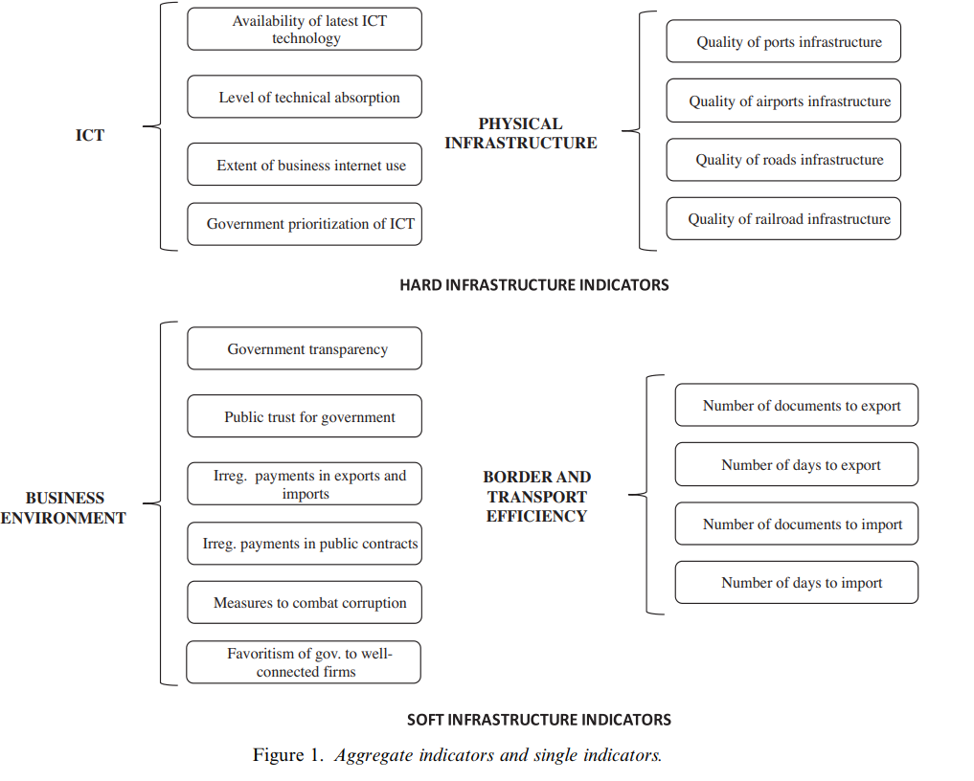
Independent Variables:-

Slide 6
Step 1:-Selection of Dependent and Independent Variables
Dependent vaiable (Y)=Gross Domestic Product (GDP) per capita
Independent variable(Xi)=
Physical infrastructure
Information and communication technology
Business
Border transport

Slide 7
Step 2:-descriptive statistical analysis
Descriptive Statistics of dataset:
 | Min. value | 1st Quartile | Median | Mean | 3rd Quartile | Max. value
GDP | 0.0782 | 0.5942 | 1.292 | 2.211 | 3.53 | 12.065
ph_infrastructure | 0.00115 | 0.2844 | 0.444 | 0.480 | 0.650 | 1
ict | 0.00802 | 0.299 | 0.453 | 0.484 | 0.659 | 1
business | 0.0123 | 0.238 | 0.359 | 0.430 | 0.611 | 1
border_transp | 0.0159 | 0.585 | 0.705 | 0.689 | 0.822 | 1
Note:-We have divided GDP by 10000 for ease.

Slide 8
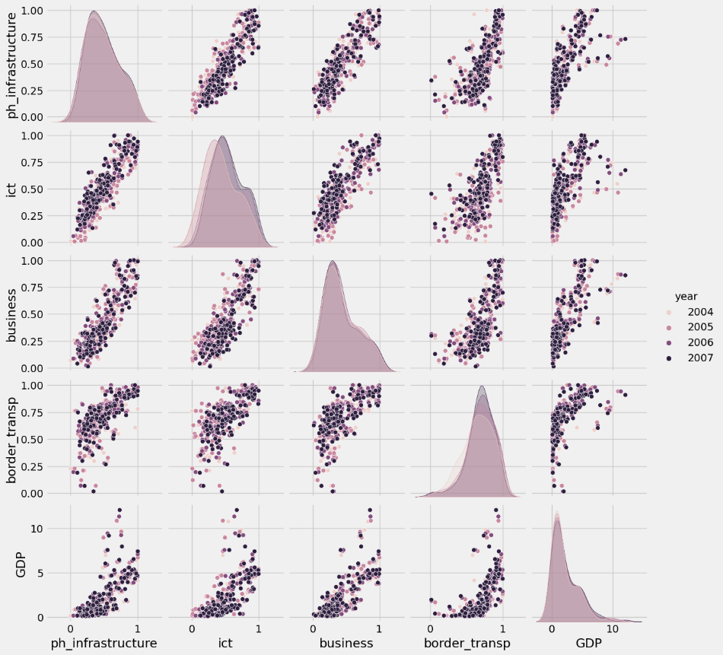
Scatter Plots:

Slide 9
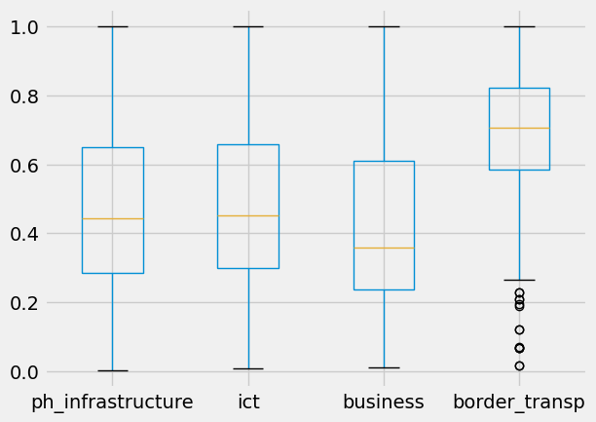
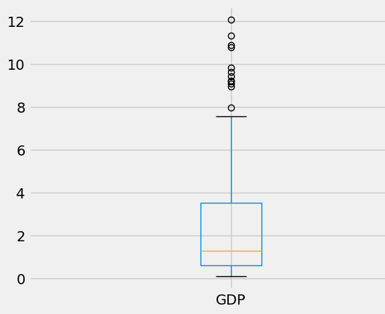
Boxplots:
Note:- clearly we see some outliers in case of border_trans and GDP, So we have modified data after removing outliers.

Slide 10
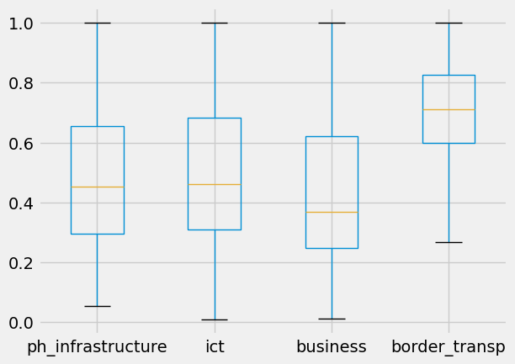
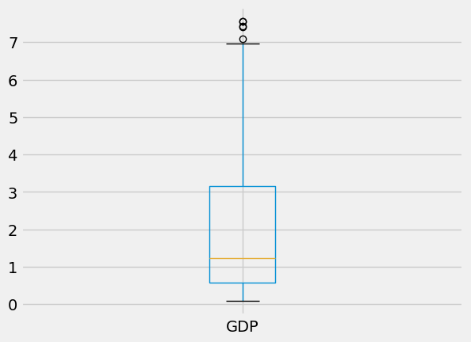
Boxplots after removing outliers:

Slide 11
Step 3: Generation of Correlation matrix:-
 | ph_infrastructure | ict | business | border_transp | GDP
ph_infrastructure | 1 | 0.875 | 0.859 | 0.684 | 0.706
Ict |  | 1 | 0.836 | 0.683 | 0.665
business |  |  | 1 | 0.681 | 0.774
border_transp |  |  |  | 1 | 0.611
GDP |  |  |  |  | 1
It is clear that there is a strong correlation between all pair of independent variables but some values are really high. However, correlation does not necessarily mean causality.

Slide 12
Step 4:White’s Test to check for the heteroskedasticity.
Null Hypothesis H0: Homoscedasticity.
Alternative hypothesis H1: Heteroskedasticity.
 | Test Statistic | P value | comments
ph_infrastructure | 15.952437 | 2.087693e-07 | Reject the null hypothesis: Heteroskedasticity is present
ict | 9.813778 | 6.814245e-05 | Reject the null hypothesis: Heteroskedasticity is present
business | 12.124404 | 7.571364e-06 | Reject the null hypothesis: Heteroskedasticity is present
border_transp | 12.245451 | 6.752348e-06 | Reject the null hypothesis: Heteroskedasticity is present

Slide 13
 | Test Statistic | P value | comments
ph_infrastructure | 15.952437 | 2.087693e-07 | Reject the null hypothesis: Heteroskedasticity is present
ict | 9.813778 | 6.814245e-05 | Reject the null hypothesis: Heteroskedasticity is present
business | 12.124404 | 7.571364e-06 | Reject the null hypothesis: Heteroskedasticity is present
border_transp | 12.245451 | 6.752348e-06 | Reject the null hypothesis: Heteroskedasticity is present

Slide 14
Step 5: Analysis of possible models:
Forward stepwise regression analysis considering all different combinations:
 | ph_infrastructure | ict | business | border_transp
 | Model 1 | Model 2 | Model 3 | Model 4
Adjusted R² | 0.490 | 0.433 | 0.592 | 0.423
 | ph_infrastructure + ict | ph_infrastructure + business | ph_infrastructure + border_transp | ict + business | ict + border_transp | business + border_transp
 | Model 5 | Model 6 | Model 7 | Model 8 | Model 9 | Model 10
Adjusted R² | 0.499 | 0.598 | 0.540 | 0.593 | 0.502 | 0.617
 | ph_infrastructure + ict + business | ph_infrastructure + ict + border_transp | ph_infrastructure + business + border_transp | ict + business + border_transp | ph_infrastructure + ict + business + border_transp
 | Model 11 | Model 12 | Model 13 | Model 14 | Model 15
Adjusted R² | 0.598 | 0.541 | 0.617 | 0.616 | 0.618

Slide 15
Step 6: test for multicollinearity
Test to check for multicollinearity was performed on model 10, 13,14 and 15:
Independent Variable | VIF (value)
business | 1.95
border_transp | 1.95
Independent Variable | VIF (value)
border_transp | 2.105
ph_infrastructure | 3.957
business | 3.975
Independent Variable | VIF (value)
border_transp | 2.148
business | 3.506
ict | 3.525
Independent Variable | VIF (value)
border_transp | 2.184
business | 4.335
ict | 4.800
ph_infrastructure | 5.386

Slide 16
Regression Analysis:
 | coef. | Robust std err | t | P>|t| | 95% confidence interval
intercept | -2.240 | 0.177 | -7.286 | 0.000 | -2.845 | -1.636
ph_infrastructure | 0.801 | 0.384 | 1.420 | 0.156 | -0.308 | 1.911
business | 5.011 | 0.349 | 9.282 | 0.000 | 3.950 | 6.072
border_transp | 2.700 | 0.357 | 4.696 | 0.000 | 1.570 | 3.831
Adjusted R² = 0.617 R² = 0.620
GDP = -2.240 + 5.011 (business) + 2.700 (border_transp) + 0.801(ph_infrastructure)

Slide 17
Conclusion:
“business” and “border_transp” are significantly contributing towards GDP.
“ict” and “ph_infrastructure” is highly correlated with each other as well as with the other two variables. So, we have omitted ict because adjusted R2 was not getting significantly affected.
“ph_infrastructure” can also be omitted as it is also not affecting adjusted R2. But it is an important indicator of Hard Infrastructure.
Thank you…..

Slide 18
Objective:-
Last time we did linear regression and we found out that the influence of physical infrastructure on GDP per capita was very less or we can say that it is coming out to be negligible in comparison to factors like business and border transport. But from our inference we know that ph infra plays a very significant role in a country's growth and development so with help of panel data this time we tried to solve this issue.
This time want to know ‘Does ph_infra really have a significance in trade and GDP?’

Slide 19
Panel Data
Panel data (also called longitudinal data) refers to data for n different entities observed at T different time periods.
We can control factors that:
Vary across entities but do not vary over time – Entity fixed effects
Vary across time but not across entities – Time fixed effects
Could cause omitted variable bias if they are omitted.
cannot be included in the regression using multiple regression

Slide 20
Different models
Regressor | (1) | (2) | (3) | (4) | (5) | (6) | (7)
ph_infrastructure | 4.9899 (0.1447) | 6.5526 (0.3150) | -0.1292 (0.2634) | 0.5309 (0.3075) | 1.4165 (0.5473) | 0.9274 (0.5619) | 1.4703 (0.6708)
business |  |  |  |  | 5.7338 (0.5254) | 5.3017 0.5365) | 5.5798 (0.5678)
border_transp |  |  |  |  |  | 1.5672 (0.4821) | 1.6859 (0.488)
ict |  |  |  |  |  |  | 0.6574 (0.6574)
Year | 2004-07 | 2004-07 | 2004-07 | 2004-07 | 2004-07 | 2004-07 | 2004-07
State Effects | No | No | Yes | Yes | No | No | No
Time Effects | No | Yes | Yes | No | Yes | Yes | Yes
P Values of variables:-
ph_infrastructure | 0.000 | 0.000 | 0.6240 | 0.0852 | 0.01 | 0.0996 | 0.0289
business |  |  |  |  | 0.000 | 0.000 | 0.000
border_transp |  |  |  |  |  | 0.0012 | 0.006
ict |  |  |  |  |  |  | 0.1402
R2 | 0.7303 | 0.4986 | 0.0007 | 0.0090 | 0.6066 | 0.6160 | 0.6179

Slide 21
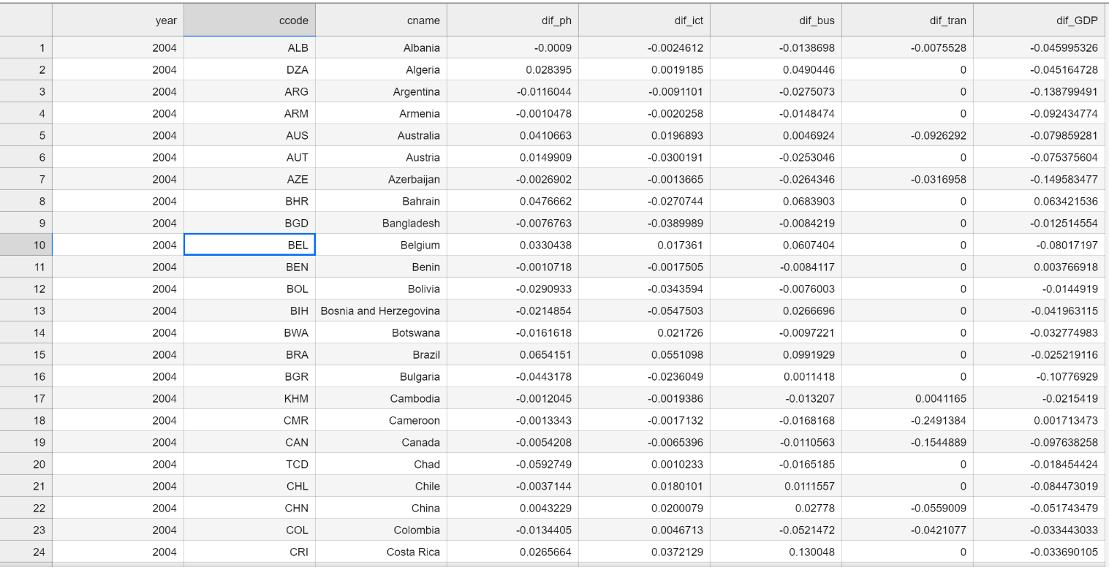
Removing variables
Border_transport --
Does not change over
time

Slide 22
Removing variables
ICT –
highly correlated with ph_infastructure as corr (ict, ph_infrastructure) = 0.875 and also with other variables
P value = 0.1402 > 0.05 in model 7 which makes it insignificant to consider it

Slide 23
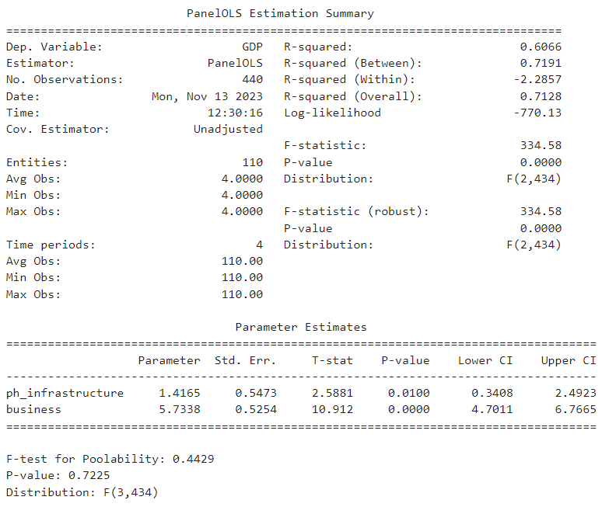
Model 5

Slide 24
Conclusion
This time from our panel data regression we have found out that the impact of physical we can clearly conclude that if a country want to improve its GDP per capita than over long period of time than a country has to definitely focus business and it should a strong physical infrastructure to support that growth in business.
(GDP)= 1.4165*(ph_infrastructure) + 5.7338*(business)+Time_fixed effects
So in long term ph_infra is one of the most important factor for country’s development.

